Slide 1


Machine Learning Convolutional Neural Networks
Portland Data Science Group
Created by Andrew Ferlitsch Community Outreach Officer August, 2017

Slide 2
Background
1988 – Invented by Yann Lecun at AT&T Bell Laboratories.
Used for Image Classification.
Acts as a pre-processing front-end to neural networks to preprocess images efficiently.
Consists of:
Convolution
Max Pooling
Flattening

Slide 3

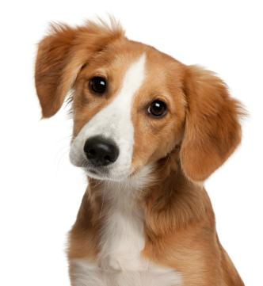
Convolutional Neural Network (CNN)
Convolution is a front-end to a Neural Network for Image Classification
Image Input
Hidden Layer
Input Layer
Output Layer
z₁
Softmax
Convolutional
Front-End
x₁
Categorical
Outputs
(e.g., Cat, Dog)
and probabilities.
z₂
x₂
z₃
x_{n}
z_{k}
Squashes output into set of
Classification probabilities
Preprocess Images
Into vector of real values
Recognition of real value inputs
Into classification of image inputs

Slide 4
Image Data
Consists of Pixel Values
Pixel Values in a Grid Layout (2D array).
One Layer (Grid) per color.
BW is pixel values 0 (black) and 1 (white).
Grayscale and color (RGB) is 0 .. 255.
Pixel = 0 (black)
BW Image 4 x 4 pixels
Grayscale Image 4 x 4 pixels
Pixel = 0 (black)
0
0
1
255
Pixel = 1 (white)
Pixel = 255 (white)

Slide 5
Color Image Data
Color (RGB) is made of 3 layers (grids or called planes or channels)
Pixel = 0 (no red)
Red Layer - Image 4 x 4 pixels
Pixel = 0 (black)
Blue Image 4 x4 pixels
0
0
255
255
Pixel = 255 (max red)
Pixel = 255 (max blue)
Pixel = 0 (black)
Green Image 4x 4 pixels
0
255
Pixel = 255 (all green)
This is the same as the
color spectrum of the three
types of cones in the retina.
All Colors are made up of some combination of Red, Green and Blue.

Slide 6
Convolution
Apply Feature Detector Filters
Apply Feature Filters across
a layer (channel) of image data.
Image Data 5x5 pixels
0
Feature Detectors
255
Also known as [image] filters
Output of application
of filters.
…
Collection of Feature Maps

Slide 7
Feature Detectors
Apply Feature Detector Filters
Apply Feature Filters across
a layer of image data.
Image Data 5x5 pixels
0
Feature Detectors
255
Also known as [image] filters
Output of application
of filters.
…
Collection of Feature Maps

Slide 8
Feature Maps
Convolution preserves the spatial relationship between
pixels by learning image features using small squares of
data.
(Image) Feature Detector Types
Edges (Lines) - Detect edges (lines) in the image.
Curves – Detect curves in the image.
Sharpen - TBA
Blur - TBA
Typically 3x3 pixel shape, but can be 5x5 or 7x7.

Slide 9
Feature Maps – Stride
Move Feature Detector across Image as a sliding window.
Moving the feature Detector across the image (up and down) is called a stride. Moving one pixel at
a time is called a stride of 1.

Slide 10
Feature Maps – Stride - Example
Apply Feature Detector Filters
Filter (Feature Detector)
BW Image Data 5x5 pixels
1
0
0
0
1
1
0
1
1
First cell holds matching pixels
From first stride.
0
1
0
1
0
0
0
1
0
1
0
1
1
0
0
0
0
1
1
1
0
Pixel match
0
0
1
0
1
Apply the 3x3 filter
as a matrix product operation on first 3x3 grid in the image.
Filter (Feature Detector)
BW Image Data 5x5 pixels
1
0
0
0
1
1
0
1
1
1
Second cell holds matching pixels
From first stride.
0
1
0
1
0
0
0
1
0
1
0
1
1
0
0
0
0
1
1
1
0
Pixel match
0
0
1
0
1

Slide 11
Feature Maps – Stride - Example
Apply Feature Detector Filters
Filter (Feature Detector)
BW Image Data 5x5 pixels
1
0
0
0
1
1
0
1
1
1
1
Completed first horizontal stride
0
1
0
1
0
0
0
1
0
1
0
1
1
0
0
0
0
1
1
1
0
Pixel match
0
0
1
0
1
Also known as convolved feature
or activation map.
Finished Feature Map
Filter (Feature Detector)
BW Image Data 5x5 pixels
1
0
0
0
1
1
0
1
1
1
1
1
1
1
0
1
0
1
0
0
0
1
3
3
1
1
0
1
0
1
1
0
0
0
Matched 3 pixels
2
3
1
0
1
1
1
0
High Detection
Pixel match
0
0
1
0
1

Slide 12
Feature Maps Reduce Image Size
By applying Feature Detectors, we are reducing the size
of the image data we keep.
Keeping only information that is important.
Keeping it in a reduced size.
Noise and extraneous data is eliminated.
Increasing the stride (i.e., from 1 to 2) will further reduce
the total image data we keep.
Increases speed of processing (less data to process).
Trade off between resolution and performance.

Slide 13
Convolutional Layer
Assemble and Collect Complete Feature Maps, one per Feature Detector
Complete Feature Map for Single Feature Detector
Feature Map is substantially smaller In size
Stride
Map to corresponding placement in complete
feature map, preserving spatial relationship.
Convolutional Layer: Collection of complete feature
maps, one per feature detector.

Slide 14
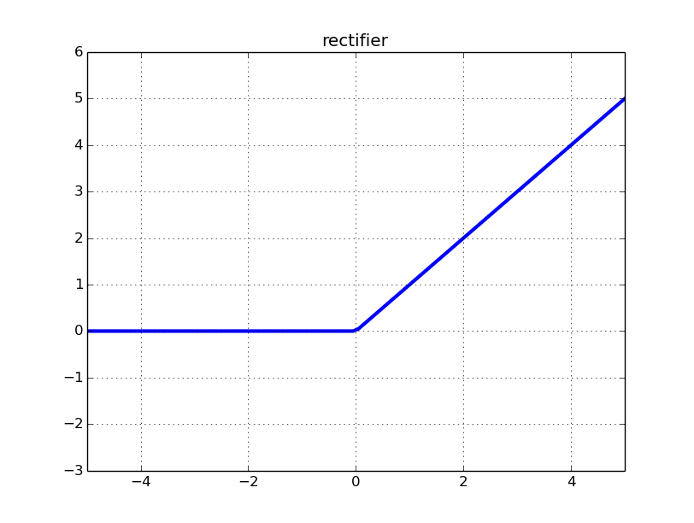
ReLU Step
The Feature Maps are processed by an ReLU function.
Convolution Layer
Rectifier Linear Unit Step
The ReLU step increases non-linearity in feature Maps.
Enhances features such as borders and elements.
All Negative Values
Replaced with 0.

Slide 15
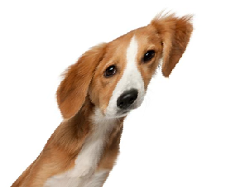
Pooling
Add Spatial Invariance to Feature Maps
Be able to recognize feature regardless of angle, direction or
skew.
Does not care where feature is, as long as it maintains its
relative position to other features.
Spatial Invariance

Slide 16
Pooling
Uses a window (typically 2x2 pixels) that is slid across
the feature map.
Finds the pixel with the highest value within the window.
Places the highest value pixel into a pooled map at the same
relative position.
Generally uses a stride of 2.
Feature Map
0
1
2
0
1
0
1
2
0
1
0
1
2
0
1
1
0
0
4
1
1
0
0
4
1
1
0
0
4
1
1
2
0
0
0
1
2
0
0
0
1
2
0
0
0
0
1
1
3
0
0
1
1
3
0
0
1
1
3
0
0
0
1
0
1
0
0
1
0
1
0
0
1
0
1

Slide 17
Pooling Example
Stride of 2
0
1
2
0
1
0
1
2
0
1
0
1
2
0
1
1
0
0
4
1
1
0
0
4
1
1
0
0
4
1
1
2
0
0
0
1
2
0
0
0
1
2
0
0
0
0
1
1
3
0
0
1
1
3
0
0
1
1
3
0
0
0
1
0
1
0
0
1
0
1
0
0
1
0
1
Window slides
off the edge.
Highest value placed in
corresponding position
In pooled map.
1
4
1
2
3
0
0
1
1
Completed Pooled Feature Map

Slide 18
Flattening
Flattening takes the pooled layer and flattens it in
sequential order into a single vector.
Vector is used as the input to the Neural Network
Convolution Layer
Pooled Layer
…
Flatten Single Vector
1
4
0
2

